Slide 1



Building the Ultimate T20 Cricket Dream Team
Welcome to the world of T20 cricket! Join us as we delve into the process of building the ultimate dream team based on key performance metrics and data analysis using Power BI.
by Sibibalan Balasubramaniam

Slide 2

Key Performance Metrics
Batting Metrics:
Bowling Metrics:
Batting Average: The average number of runs a batsman scores per dismissal.
Bowling Average: The average number of runs conceded per wicket taken.
Strike Rate: The number of runs scored per 100 balls faced.
Economy Rate: The average number of runs conceded per over bowled.
Total Runs Scored: The overall runs scored by the player in a specific period.
Bowling Strike Rate: The average number of balls bowled per wicket taken.
Total Wickets Taken: The overall number of wickets taken by the player in a specific period.

Slide 3
Player Selection Process
1
Key Metrics Analysis
Analyze player statistics based on key performance metrics to identify top performers.
Team Synergy
2
Formulate a team strategy considering each player's strengths and role requirements.
3
Collaborative Decision-Making
Involve the team management, coaches, and selectors in the final decision-making process.

Slide 4
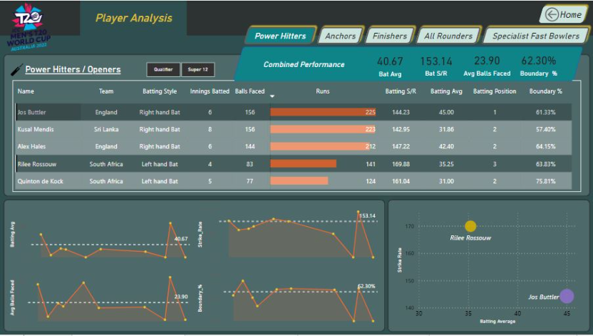
Team Composition: The Perfect Balance
Our dream team is meticulously composed of openers, anchors, finishers, all rounders and specialist fast bowlers. This strategic combination ensures a well-rounded squad capable of dominating opponents in all aspects of the game.
Openers: Setting the Stage
Player 1 - Jos Butler stands out as a dynamic opener, known for his striking ability and an impressive batting average of 45 runs. His reliability across all matches is commendable, and his proficiency as a wicket-keeper adds a multifaceted dimension to the team.
Alex Hales: While Alex Hales may not be as consistent in all matches, his potential as a second opener cannot be ignored. His ability to launch fierce attacks on the opposition makes him a valuable asset.
Player 2 - Rilee Rossouw: In pursuit of a left-handed combination and a higher strike rate, Rilee Rossouw emerges as the ideal choice. His striking abilities are truly impressive.
When we combine the performance of these openers, the result is a potent pairing that delivers an average of 40 runs at a remarkable strike rate exceeding 150. This translates to a minimum total of 180 runs if they complete the full 20 overs, with over 60% of these runs stemming from boundaries. Moreover, they are expected to anchor the innings for at least 4 overs, given their ability to consistently face deliveries throughout the innings. This combination promises an electrifying start to our Dream Team's batting lineup.

Slide 5
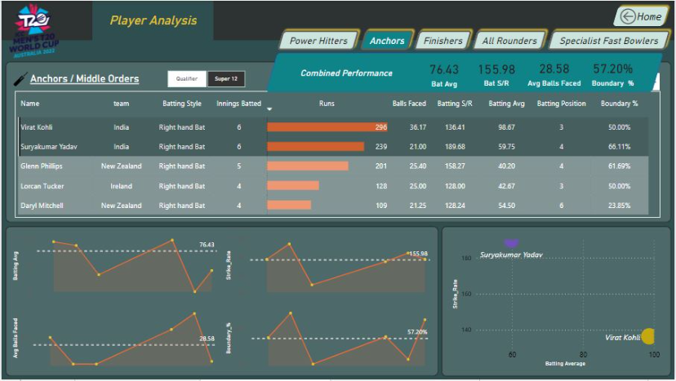
Anchors: Keeping the Ship Afloat
Our anchors bring stability and composure to the team, playing crucial roles in building partnerships and consolidating the innings even under challenging circumstances.
Player 3 - Virat Kohli emerged as the standout performer in our analysis, amassing the highest number of runs in the T20 World Cup. His remarkable batting average of nearly 99 runs is a testament to his consistency and class.
Player 4 - Surya Kumar Yadav stands out for his incredible strike rate and penchant for finding the fence. An impressive 66% of his runs are derived from boundaries, showcasing his aggressive approach and ability to keep the scoreboard ticking.
Even in situations where the openers falter, Virat Kohli, Surya Kumar Yadav remains a beacon of hope, with an expected average score of at least 76 runs, and a substantial 57% of those runs coming from boundaries.
Player 5 - Glenn Phillips : Selected for their dynamic and aggressive batting style, especially in the latter stages of an inning. Their impressive strike rate, coupled with the ability to thrive in high-pressure situations, distinguishes them. Considering the batting average and strike rate Glenn Phillips emerges as a fitting choice for this role.

Slide 6
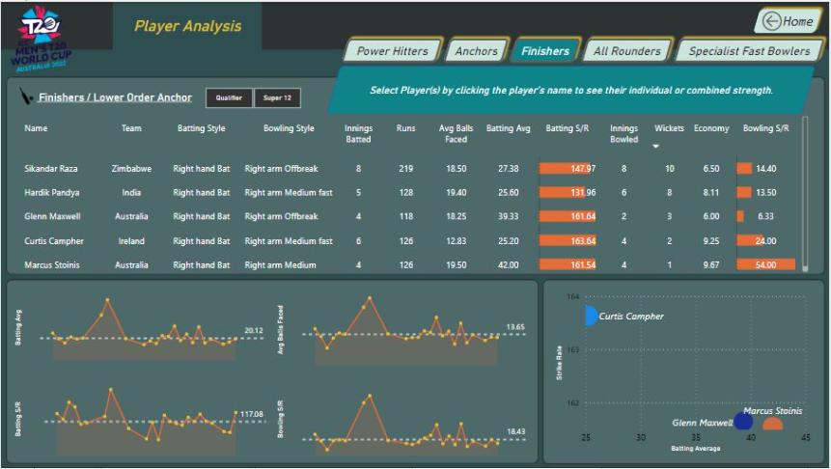
Finishers: Sealing the Victory
Our finishers possess the ability to turn matches on their heads, executing calculated shots with precision in the high-pressure closing stages of the game.
In our quest for a finisher, we prioritize a batting all-rounder, someone who can score runs at a high strike rate to anchor the innings or even contribute with their skills as a fast or spin bowler.
1
Hardik Pandya - The Balanced Option
Hardik Pandya offers a balanced approach. While his batting strike rate is commendable, his batting average and consistency may not be as strong. However, his bowling skills are noteworthy. If the 6th position demands a bowler, he is a valuable contender. Yet, considering our already excellent bowling resources, we may prioritize batting in this role.
Glenn Maxwell - The All-Round Dynamo
2
Glenn Maxwell is an enticing option, despite his primary role as a spinner. His exceptional bowling economy of around 6 and a striking bowling strike rate of 6 demonstrate his prowess. Notably, his batting averages almost 40 runs, paired with a striking strike rate of 161, underlines his batting excellence, making him a dynamic choice for this role.
3
Marcus Stoins - The Power Striker
Marcus Stoinis may not be as proficient with the ball, but his batting skills shine. With a batting average of 42 runs and a strike rate just above 161, he brings immense firepower to this position. If we're looking for a dynamic batsman with a high strike rate, Stoinis is the ideal choice.
Player 6 - Marcus Stoinis: With an emphasis on bolstering our batting strength, Marcus Stoinis emerges as the standout choice for Player 6, as his power-hitting and ability to anchor the innings align perfectly with our finishing needs

Slide 7

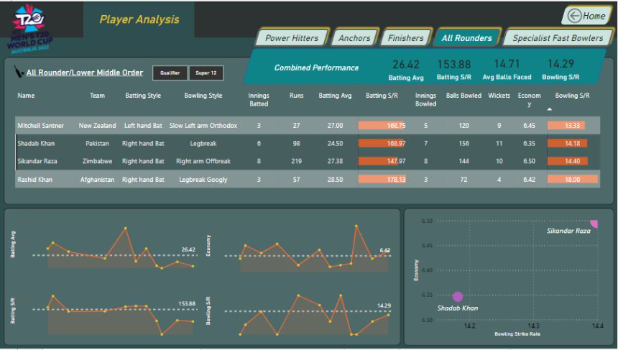
All-Rounders: Game-Changing Prowess
All-rounders are the game-changers on the field. With their dual talents, they can tip the balance in our favor, whether through vital runs or crucial wickets.
Our all-rounder selection hinges on a unique dual requirement: proficiency in spin elements combined with impactful batting skills.
Player 7 - Sikandar Raza : In the event that Player 6's performance falls short, we rely on Player 7 to step up and deliver with the bat. Sikandar Raza is the top choice for this pivotal role, boasting a strike rate of approximately 147 and a solid batting average that aligns seamlessly with the team's current needs.
Player 8 - Shadab Khan emerges as a multifaceted all-rounder. His impeccable economy and a striking bowling strike rate complement his equally impressive batting strike rate, all underpinned by a track record of unwavering consistency.

Slide 8

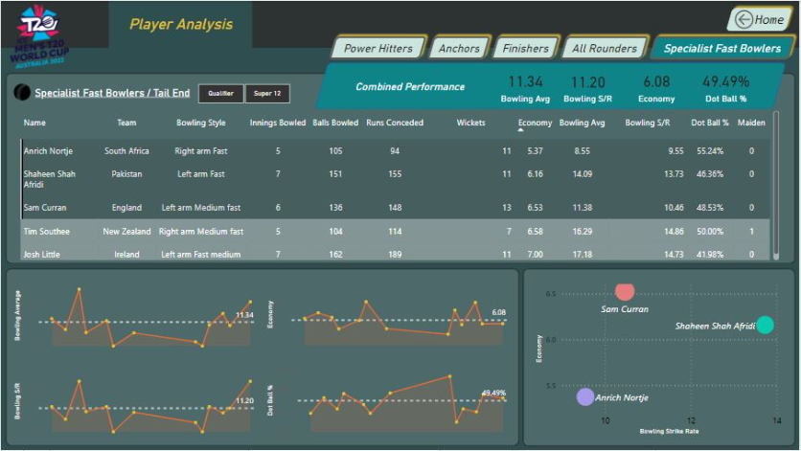
Fast Bowlers: Unleashing Thunderbolts
Our specialist fast bowlers possess raw pace, accuracy, and the ability to dismantle batting line-ups, leaving opponents shell-shocked and wickets shattered.
Player 9 - Sam Curran is a remarkable fast bowler, boasting an economy rate of 6.53 and an impressive bowling average of approximately 11 runs per wicket. This means that he consistently delivers a wicket for every 11 runs he concedes. What sets him apart is his extraordinary bowling strike rate, which suggests that over the course of a full 4-over spell, he is likely to claim around 2 wickets.
Player 10 - Anrich Nortje has proven his mettle with 11 wickets to his name and an economy rate that has just crossed the 5-run mark. His ability to pick up wickets in less than 10 balls makes him an indispensable choice. Being a fast bowler further solidifies his position in the team.
Player 11 - Shaheen Shah Afridi, a left-arm fast bowler, possesses the skill set to disrupt our opponents' strategies. His variations and swing can undoubtedly create chaos in the opposition's batting lineup.
When we consider their collective performance, they have the potential to dismantle the entire opposition for approximately 113 runs if they complete their full 20-over quota. Moreover, their combined strike rate indicates they are likely to take a wicket roughly every 11 balls they deliver. Impressively, their collective economy rate stands at just 6, making it exceptionally challenging for the opposition to accumulate more than 36 runs in the initial 6 overs. Additionally, they consistently produce dot balls, ac counting for nearly 50% of their deliveries, adding immense pressure on the opposition's batsmen.

Slide 9
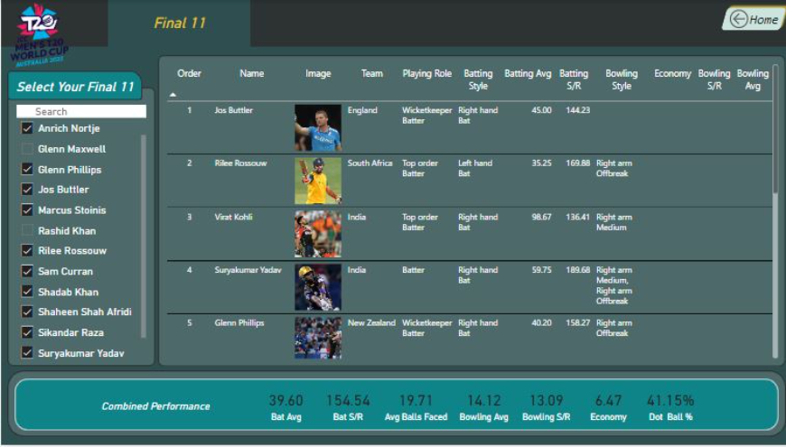
The Final 11: A Fusion of Brilliance
Combining outstanding performances and a perfect blend of skills, the final 11 of our dream team is designed for victory in the T20 World Cup.
Openers
Anchors
Finishers
All Rounder
Specialist Fast Bowlers
1. Jos Buttler
3. Virat Kholi
6.Marcus Stoinis
2. Rilee Rossouw
4. Surya Kumar Yadav
7.Sikandar Raza
8.Shadab Khan
9. Sam Curran
5.Glenn Phillips
10. Shaheen Shah Afridi
11. Anrich Nortje
Conclusion:
In summary, our Dream Team boasts an average batting strike rate of nearly 155, promising a minimum total of around 180 runs at the conclusion of 20 overs. Additionally, each player is expected to contribute at least 3 overs in batting, strengthening our innings.
On the bowling front, our stringent economy rate, not exceeding 6.5, ensures that the opponents are limited to approximately 130 runs. Furthermore, our exceptional dot ball percentage, at 41%, restricts the opposition to a strike rate of just 60%, solidifying our path to victory.
This Dream Team not only meets but greatly surpasses our expectations, confidently delivering a performance that guarantees us a score of at least 180 runs while conceding no more than 150, setting the stage for success in our dream final 11 lineup.

